Slide 1
Fake News Classification →ML Model
Fliprobo.com

Slide 2
Problem statement and solution
Problem Statement
The authenticity of Information has become a longstanding issue affecting businesses and society, both for printed and digital media. On social networks, the reach and effects of information spread occur at such a fast pace and so amplified that distorted, inaccurate, or false information acquires a tremendous potential to cause real-world impacts, within minutes, for millions of users. Recently, several public concerns about this problem and some approaches to mitigate the problem were expressed.
Solution
In this project, We have to build a Machine learning model that can classify whether the news is fake (1) or notfake (0).

Slide 3
Choosing the evaluation metrics
We are choosing accuracy as our evaluation metrics for this image classification project. But the full classification report along with Visualizations are incorporated in the project

Slide 4
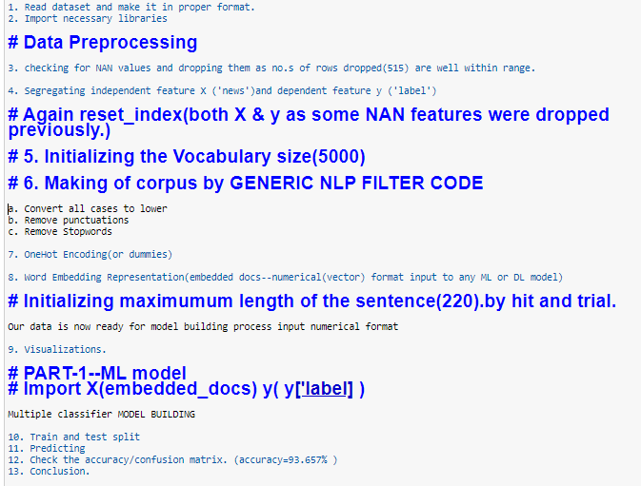
ML model Flow Contd……

Slide 5
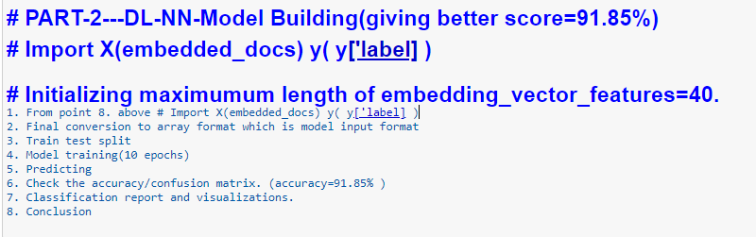
DL-NN Model flow

Slide 6
Summary of model builtup(Xgboost model)
1) Import the .csv data file.
2)Clean the data.(preprocessing )
***Processing of Text data(NLP-embedding technique)-corpus list created.
3)One hot encoding on the corpus list (Each word inside corpus List is given different numbers..
4) X,y[‘label’] are independent and dependent features.
5) traintestsplit the train data with 20% data for test purpose.
6) Multiple Model structure development.
7) Making a list of all the algorithms
8) Fit the model.
9) Evaluate the model along with Visualizations.
10) Making a dataframe with all the scores of all the algothim and choosing the Xgboost as our final algorithm.
11)GridsearchCV on Xgboost model.
11)Predict and evaluate on test data.
12) save model--→>>model.save(“fakenewsxgbmodel")
13)load model→> model = load_model(‘fakenewsxgbmodel')
14) Saving final predictions in file.csv format
15) Conclusion

Slide 7
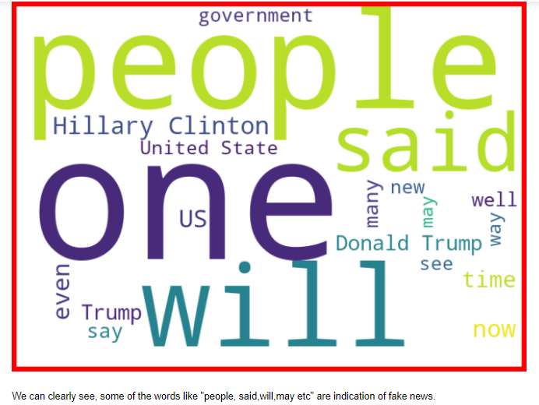
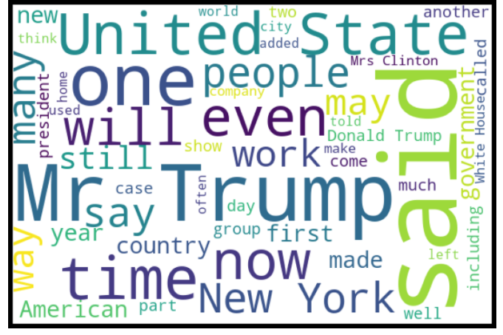
Visualization
Fake NotFake

Slide 8
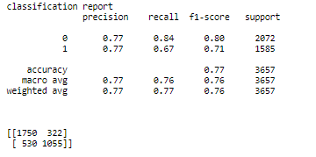
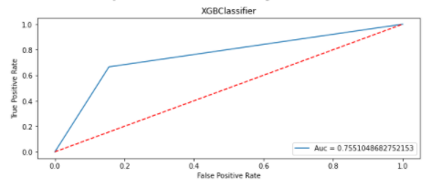
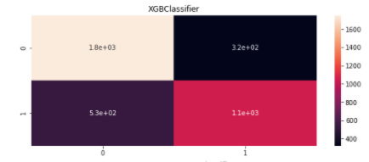
Visualization
Classification Report Auc-Roc

Slide 9
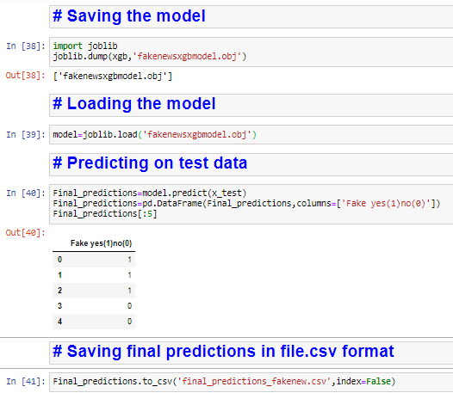
Testing , Evaluating , Saving & loading the (.obj) ML model

Slide 10
conclusion
In this Machine Learning model
Whether the ‘news’ is Fake(1) or NotFake(0) can be predicted using the above model.
By using sklearn(XGboost) I have build a machine learning model that will predict whether the news is fake(1) or not fake(good news(0)).
Thank you..

